Slide 1
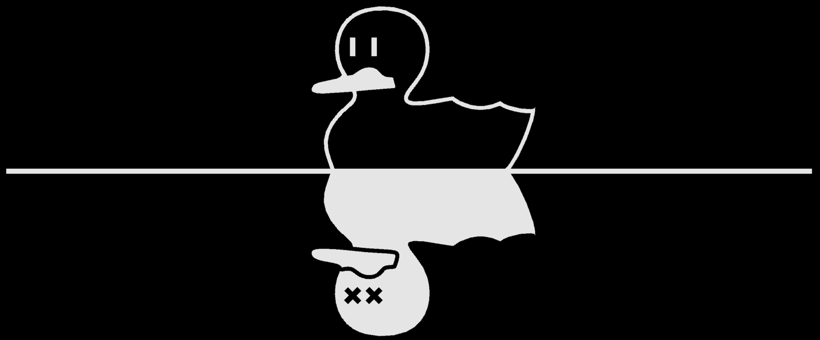
DQM Knapsack for COVID Vaccine Distribution
Manjunath Rao, Vincent Pisani, Gary Sung, Anna Krista Almazán Favela

Slide 2
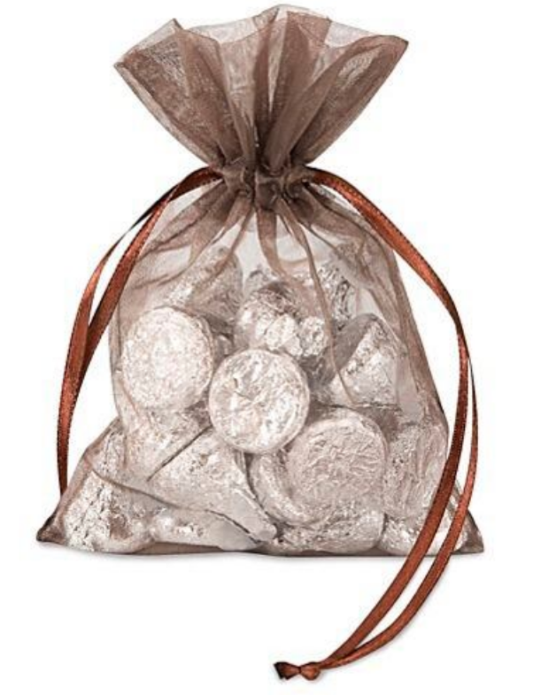
Knapsack Problem
It’s Halloween and you’re going trick-or-treating with friends.
A lady hands out small bags with a wide assortment of treats. You and your friends need to maximize the value (candy) without breaking the bag (weight)
Each item in the knapsack has a value and weight associated.

Slide 3
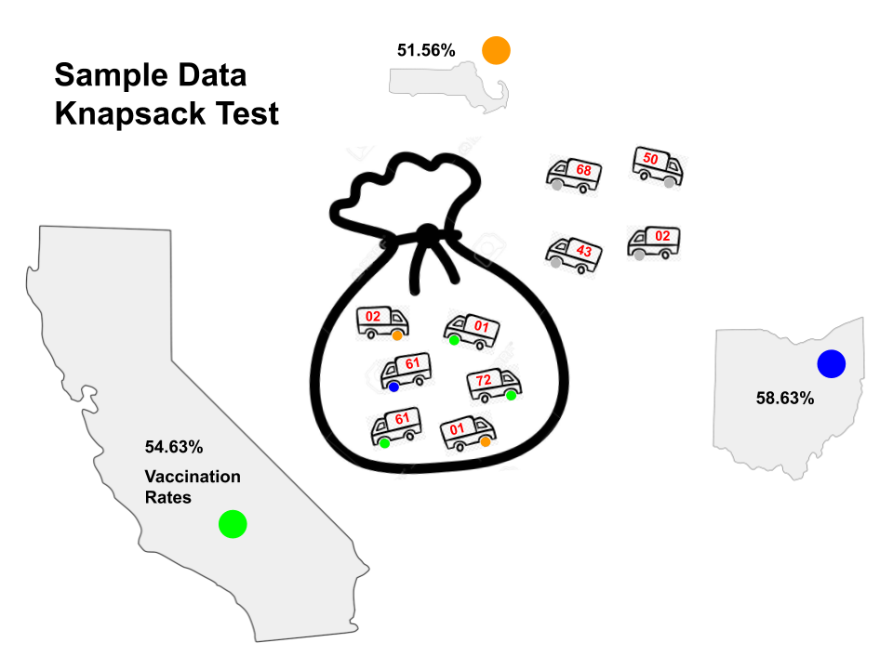
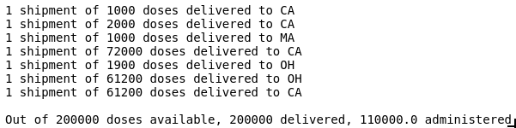
Preset:
Delivery locations
Vaccine doses
Vaccination rates
Find optimal Knapsack
Output:

Slide 4
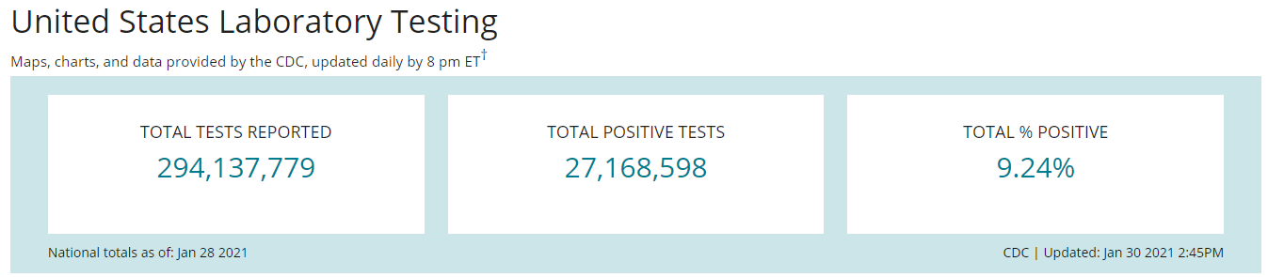
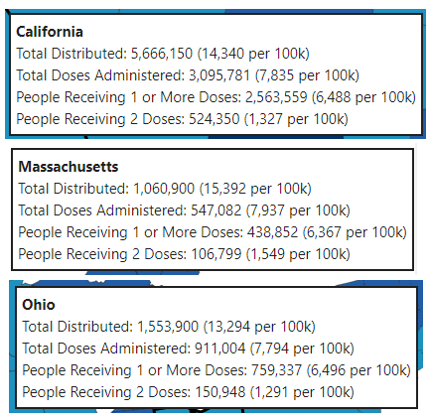
Gathered Data CDC

Slide 5
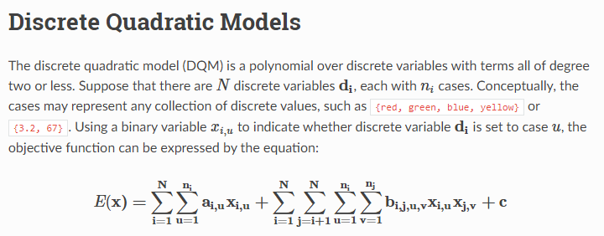
Source

Slide 6
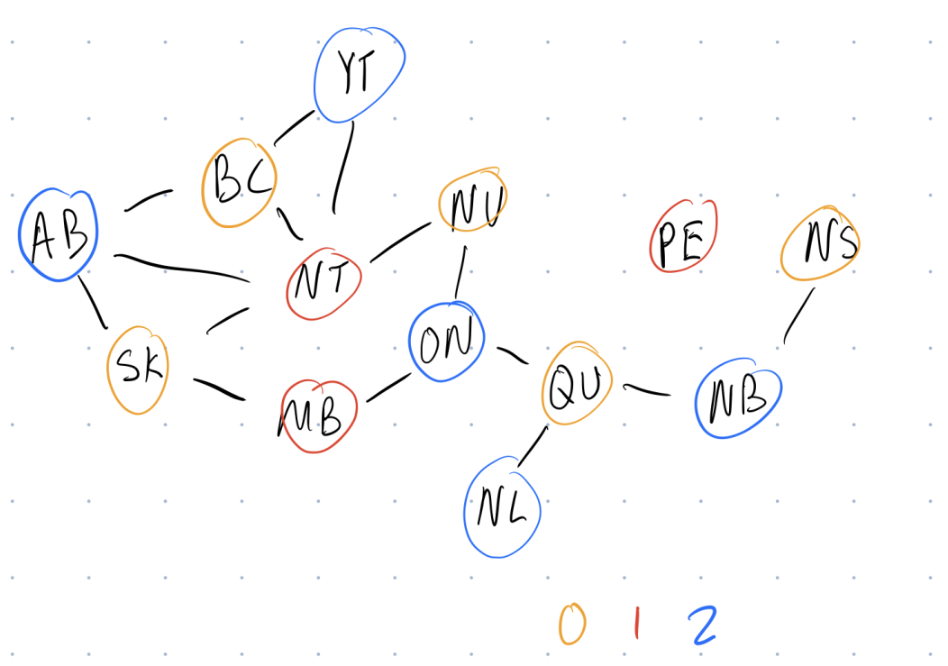
DQM Graph Coloring
Source

Slide 7
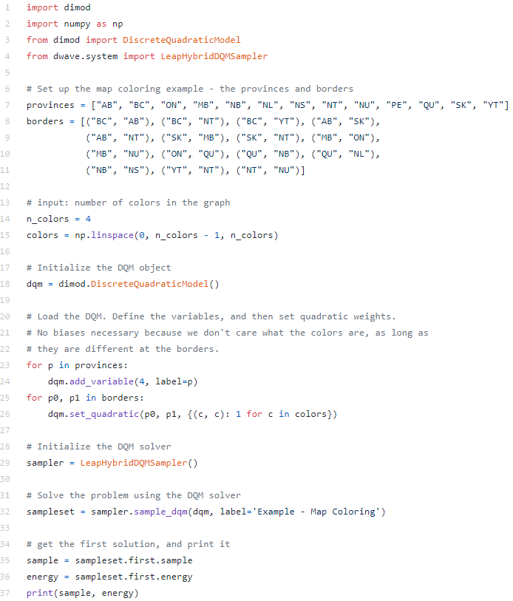

Slide 9


DQM Equations
Obj function
Lagrange Parameter
Close as possible to Max Weight
Expanded Form

Slide 10
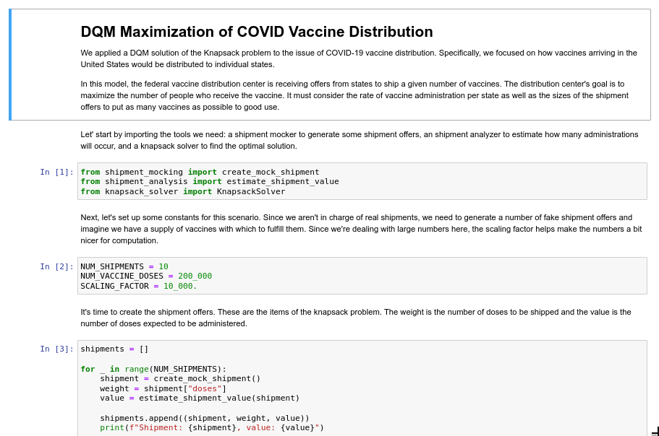
Jupyter Notebook
Try it Out!

